Slide 1
A Revolution in Early
Cancer Detection
Interactive and Reproducible Analysis Reports in R
BBSW 2019, Nov 7-8 2019
Daniel Civello
Clinical Data Science

Slide 2
Siddhartha Bagaria
H John Kim
Razvan Musaloiu-E
Thank you GRAIL technical staff, current and former, especially:

Slide 3
Motivation: Communication and Engagement
Practical Interactive Tools
Levels of Reproducible Analysis
Agenda

Slide 4
Motivation
Communication and Peer Engagement.
Changing how people work together (often at the intersection of software and science) is crucial to building reproducible research
More than just tooling or a language
“Tools that enable going from data to knowledge”
Adopting tools which streamline how analysis takes place, how decisions are made and how they’re communicated need to be embraced

Slide 5
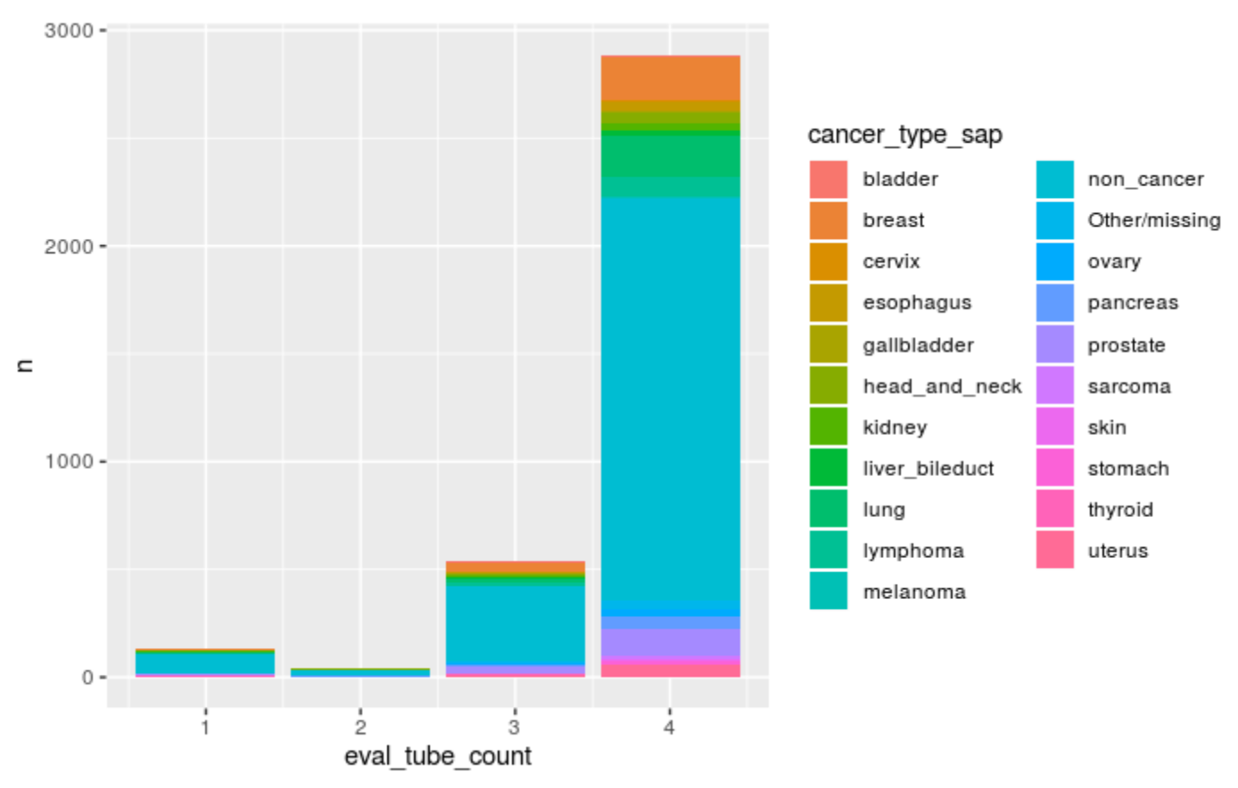
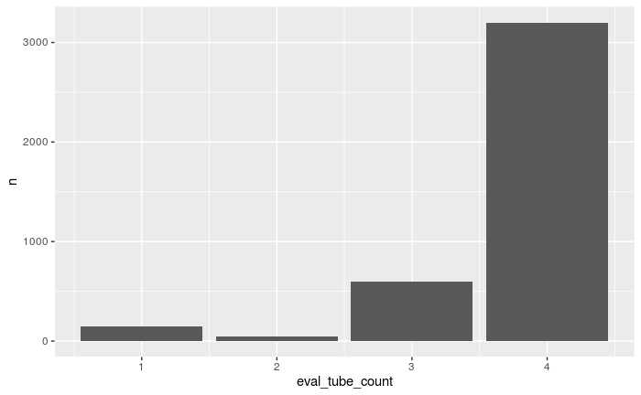
Motivation
Communication and Peer Engagement.
“Can you create a plot of the number of participants in our study and the count of available tubes of blood they have?”
“Okay, great, can you add a breakdown of enrolled cancer status to this?”
simulated data from GRAIL CCGA study

Slide 6
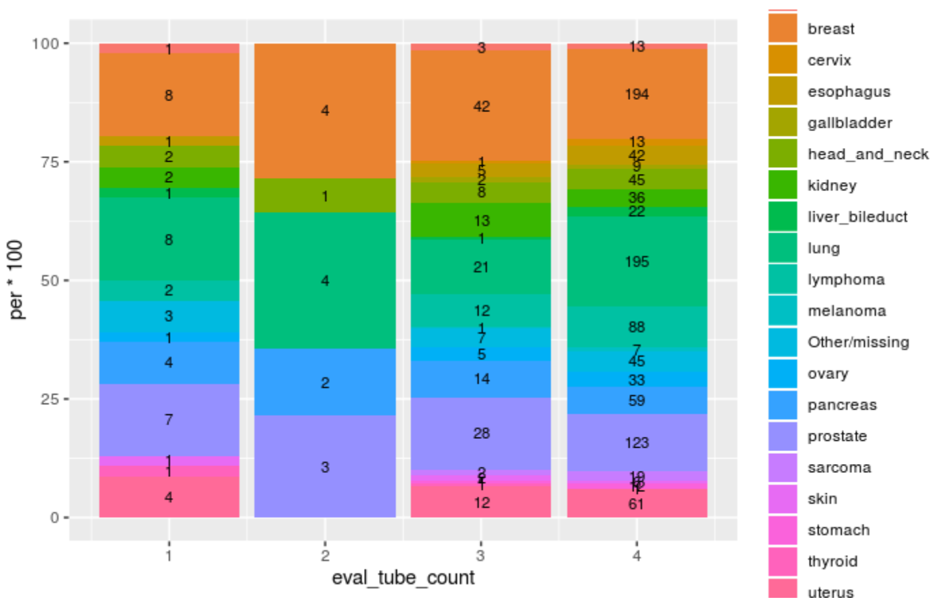
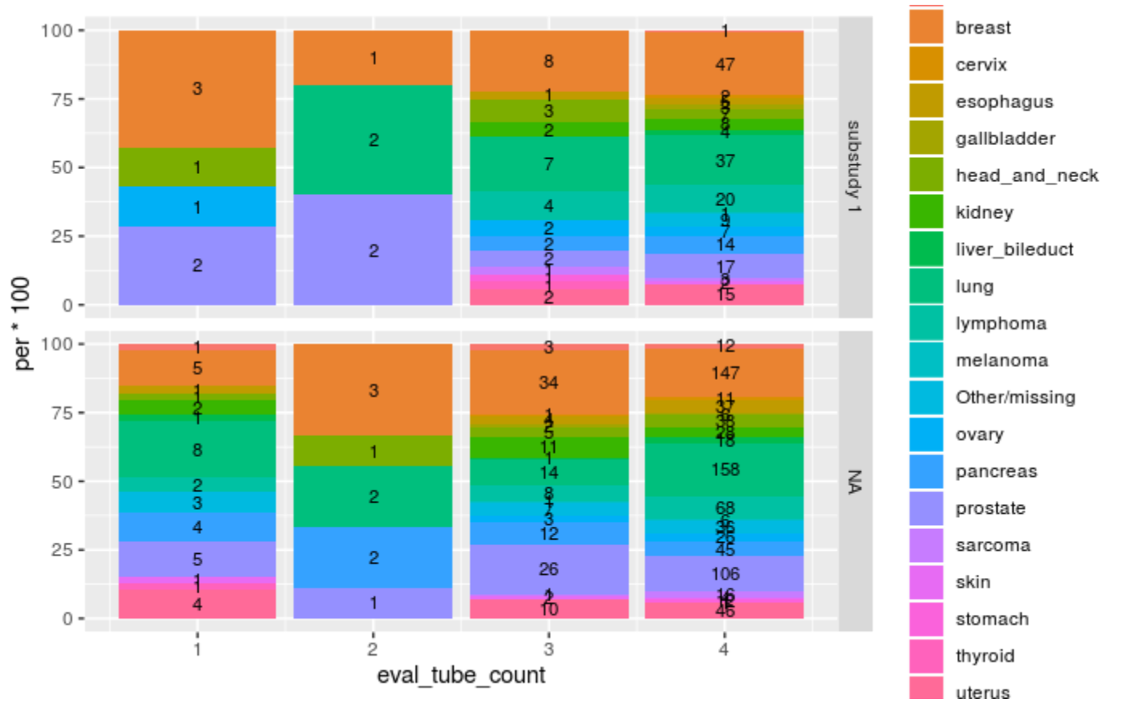
Motivation
Communication and Peer Engagement.
“I’m not interested in non-cancer, and that one category is too small to see...”
“Okay, how many of these participants have been analyzed in a previous cohort?”
simulated data from GRAIL CCGA study

Slide 7
Motivation
Communication and Peer Engagement.
The Real Question
“Is there a correlation between blood collected and the cancer for the participants in our study?”
How far did we get?

Slide 8
Practical Interactive Tools

Slide 9



Interactive Tools
Example workflow for EDA
Input Data
R code & Rmd
htmlwidgets

Slide 10
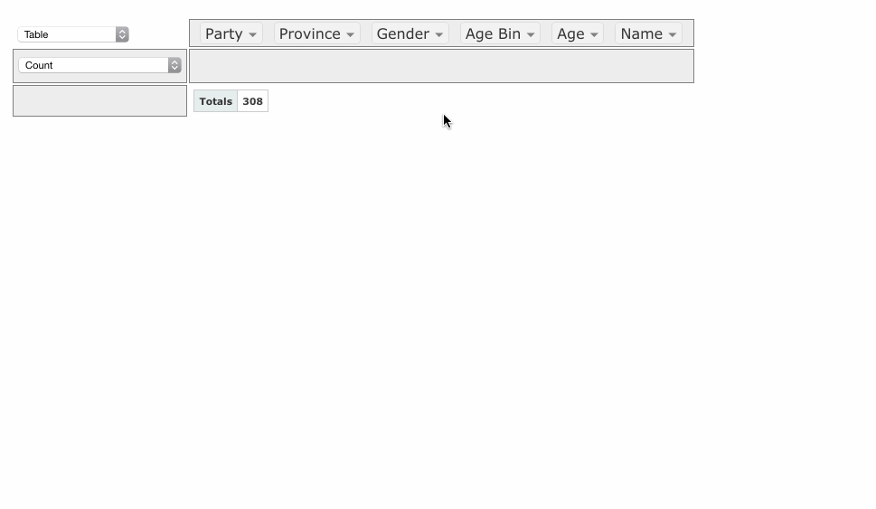
Interactive Tools
Examples rpivotTable, DT, esquisse
Can be embedded into
a markdown!
https://github.com/nicolaskruchten/pivottable/wiki/UI-Tutorial

Slide 11
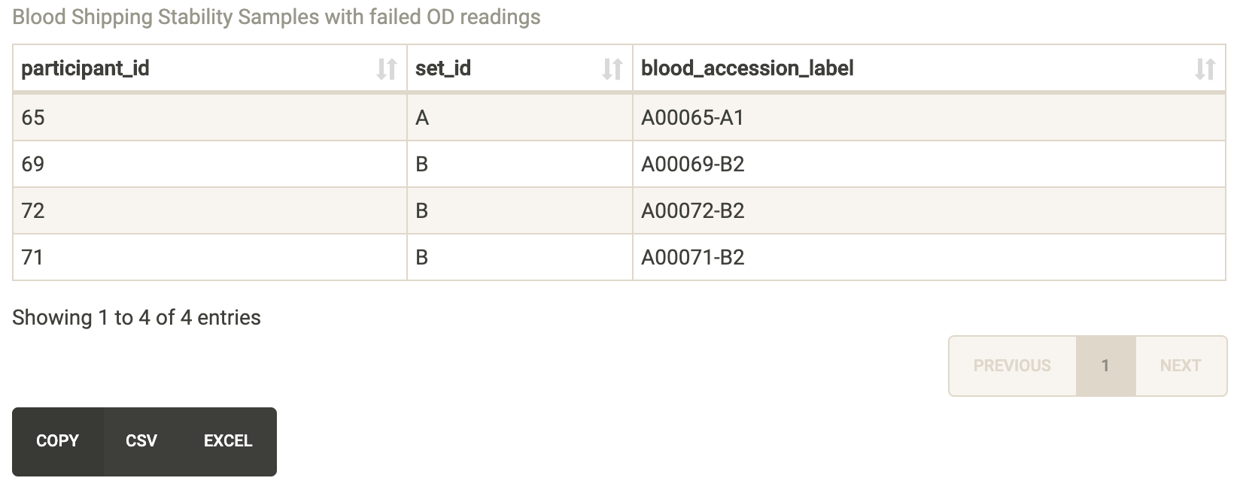
Interactive Tools
Can be embedded into
a markdown!
Examples rpivotTable, DT, esquisse
simulated data from GRAIL CCGA study

Slide 12
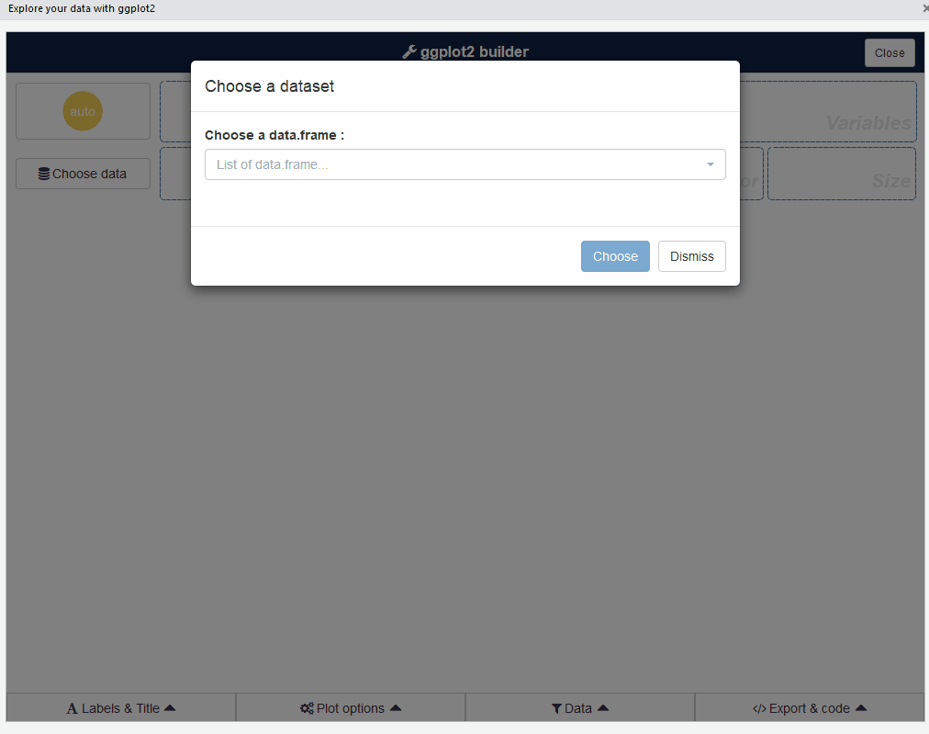
Interactive Tools
Examples rpivotTable, DT, esquisse
Can be embedded into
a markdown!
https://dreamrs.github.io/esquisse/index.html

Slide 13
Improve Communication and Engagement Through Tools?
Sure!
Shift how people work together (understanding the why)
The correct data can be combined in the first place
Interactive tools can be used (versus iterative static snapshots) to generate knowledge, which is the ultimate goal.
So maybe now my new title of this talk is:
“An environment fostering collaboration and innovative tooling can turn data into insight”
but I’m forgetting the reproducibility aspect...

Slide 14
What type of “Reproducibility” do I mean?
Reproducibility

Slide 15
Ten Simple Rules for Reproducible Computational Research
For Every Result, Keep Track of How It Was Produced
Avoid Manual Data Manipulation Steps
Archive the Exact Versions of All External Resources Used
Version Control All Custom Scripts
Record All Intermediate Results, When Possible in Standardized Formats
For Analyses That Include Randomness, Note Underlying Random Seeds
Always Store Raw Data behind Plots
Generate Hierarchical Analysis Output, Allowing Layers of Increasing Detail to Be Inspected
Connect Textual Statements to Underlying Results
Provide Public Access to Scripts, Runs, and Results
S. Bagaria
https://journals.plos.org/ploscompbiol/article?id=10.1371/journal.pcbi.1003285
Notes:
External programs can also mean external data, tools, packages, etc.

Slide 16
Levels of Reproducible Analysis
Why?
Not every analysis needs to be publication ready
Exploratory analysis is OK to be local if working independently
But, also need a process to "graduate" exploratory analysis
To verify findings are reproducible
To collaborate internally
To present to an internal audience (lab, team, company, etc.)
To collaborate externally
To publish in journals
S. Bagaria

Slide 17

Local Rendering is Not Reproducible
Input Data
R code

Slide 18

Improving Reproducibility with Tools
Code hosting
Build system
Common in software development, newer concept to comp. analysis
Input Data
R code
+
Render script
Build Server

Slide 19





Full Data Provenance with Reflow™
Levels of reproducibility...
Data processor
Processed Data
Git Revision Tag
2019-05-04.jkim-143843.024f331-dev Date .user-time. checksum-status
Git Revision Tag
2019-05-04.jkim-143843.024f331-dev Date .user-time. checksum-status
Report Rendering Container
Git Revision Tag
2019-05-04.jkim-143843.024f331-dev Date .user-time. checksum-status
Git Revision Tag
2019-05-04.jkim-143843.024f331-dev Date .user-time. checksum-status
S. Bagaria

Slide 20
Internally at GRAIL
When we use fully reproducible workflows at GRAIL
For business decisions
For external publications
Considered for internally presented results (smaller team meetings)
When mistakes could be embarrassing or waste time
Considered for continuous maintenance and testing
Rarely for disposable code
Analysis never meant to run more than once
Exploratory

Slide 21
Summary
If you take away anything from this talk..
The science, the analysis, and the engineering all need to partner
Tools that are easy to adopt are needed to foster communication
Reproducibility needs to be established at the start and should not be the exception
Engineering and analysis can be coupled with tools
(and it doesn’t add to timelines)

Slide 22
Thank you!
github.com/grailbio
dcivello@grailbio.com

